Slide 1

COVID-19 Exploratory Data Analysis (EDA) Using Pandas
Analyzing the Impact of COVID-19 Using Data Science.
Notes:
1

Slide 2

Global COVID-19 Trends: Cases, Deaths, and Recoveries
Early Spread
Vaccination Impact
Initial outbreak and spread.
Effect of vaccines on case rates.
1
2
3
4
Peak Infections
New Variants
Highest infection rates.
Emergence of new variants.
Notes:
4

Slide 3

Project Objectives: Unveiling Insights from COVID-19 Data
1
Data Collection
2
Trend Identification
Gather comprehensive COVID-19 datasets.
Identify global pandemic trends.
3
Impact Assessment
4
Forecasting
Assess the socioeconomic impact.
Predict future disease trends.
Notes:
2

Slide 4
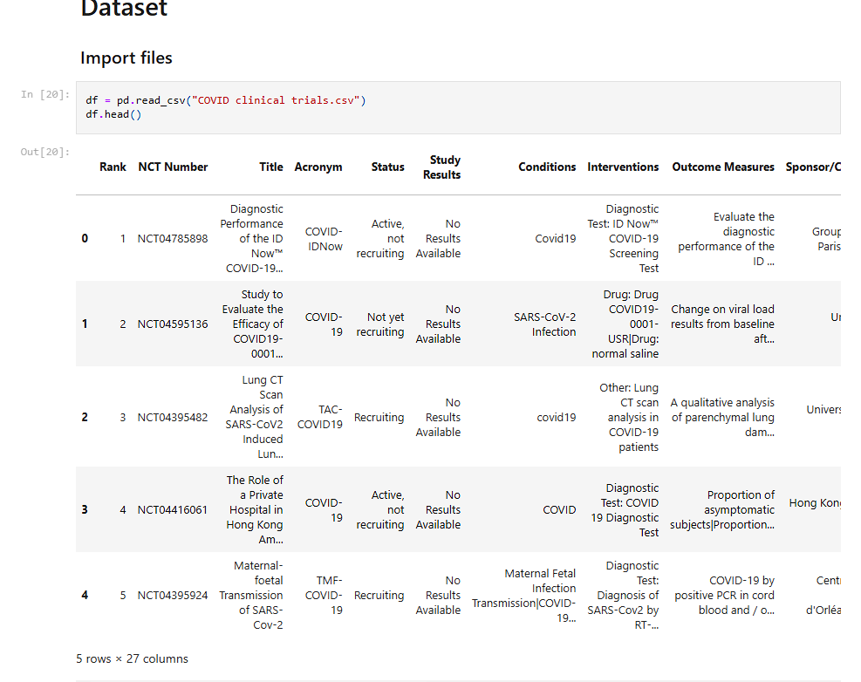
DATASET

Slide 5
Data Acquisition and Cleaning with Pandas
Loading Data
Cleaning Data
Transforming Data
Feature Engineering
Importing data sets into Pandas.
Handling missing and incorrect data.
Converting to correct data types.
Creating more features from existing data.
Notes:
3

Slide 6
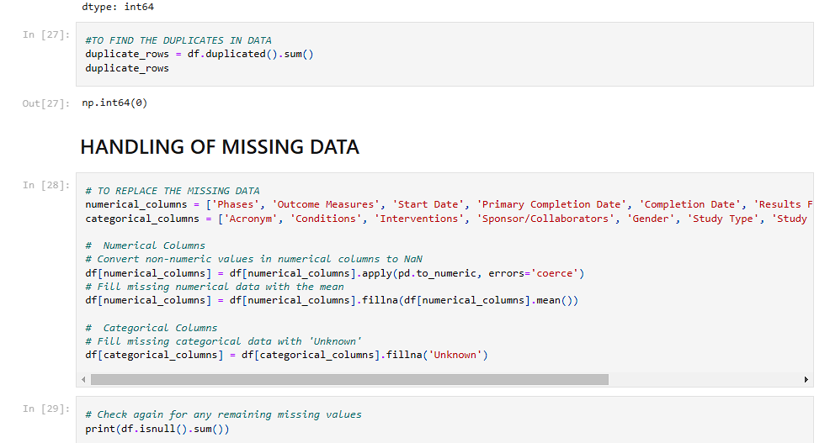
DATA CLEANING

Slide 7


Impact Analysis: Socioeconomic Factors & COVID-19
Economic Impact
GDP changes due to lockdowns.
Education
School closures and learning loss.
Healthcare
Strain on healthcare systems.
Employment
Job losses across sectors.
Notes:
5

Slide 8
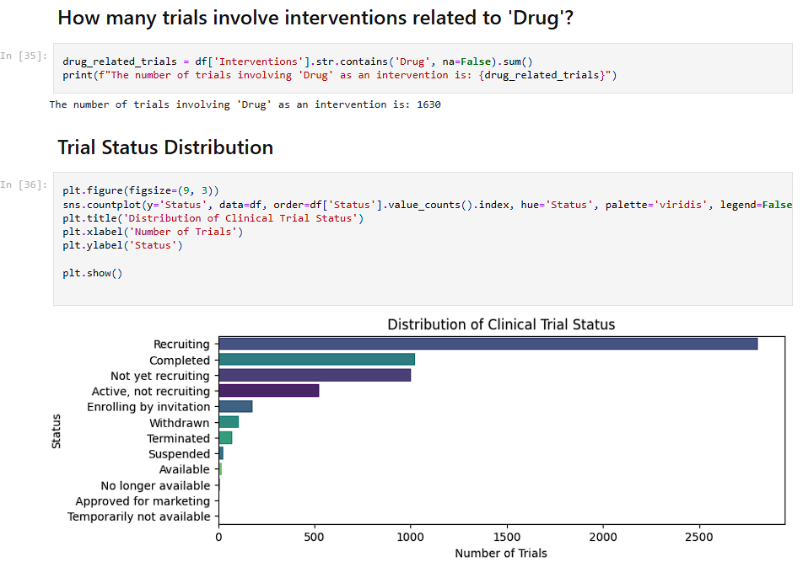
Distribution of clinical trails

Slide 9
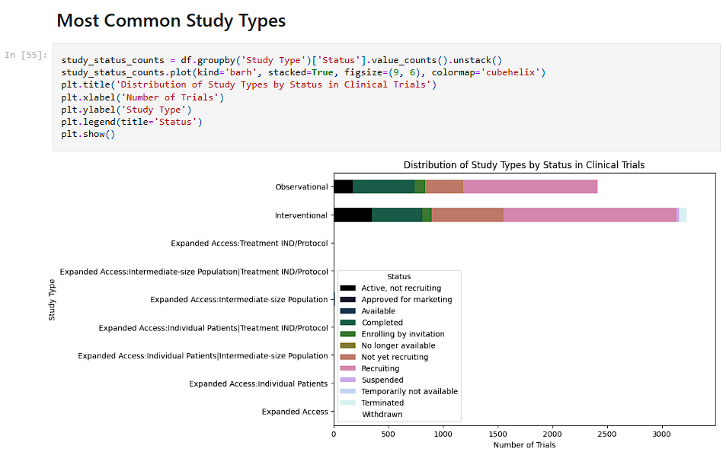
Distribution of Study Types by Status in Clinical Trials

Slide 10




Visualizing Key Findings: Interactive Charts and Maps
Interactive Charts
Use visualization libraries to create interactive charts.
Geospatial Analysis
Mapping data to identify hotspots.
Data Exploration
Enable data exploration through UI controls.
Notes:
6

Slide 11
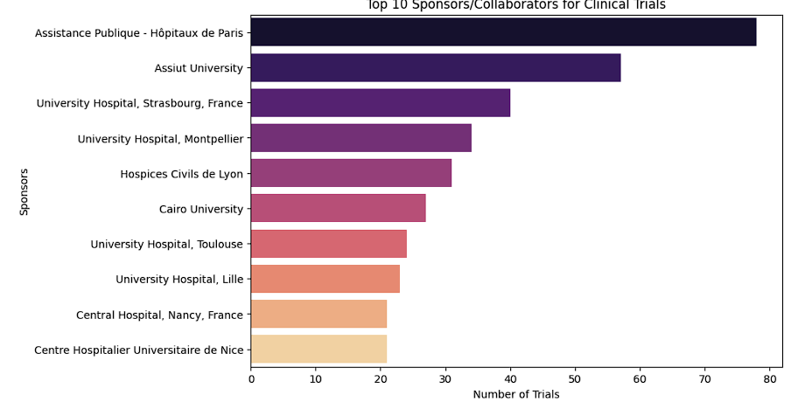
Top 10 Sponsors/Collaborators for Clinical Trials

Slide 12




Predictive Modeling: Forecasting Future Trends
Data Preparation
1
Model Selection
Prepare data for modeling.
2
Choose appropriate model.
4
Evaluation
Training
3
Evaluate the model.
Train model on existing data.
Notes:
7

Slide 13

Conclusion: Key Insights and Future Research Directions
1
Key Insights
Summarize insights from the EDA.
2
Lessons Learned
Highlight successful techniques.
3
Future Studies
Suggest further research areas.
4
Policy Recommendations
Inform future responses.
Notes:
8

